Slide 1
System Analysis and Design
Unit 1: Origin of Software

Slide 2
System Acquisition
Acquisition means to own something
Where one person or company buys another and transfers ownership.
System Acquisition means the design, development and production of new systems or the modification to existing systems that involve redesign of the system or subsystems
Now a days instead of building system from scratch, they invest in packaged software, open-source software, and outsourced services.

Slide 3
Outsourcing
If one organization develops or runs a computer application for another organization, that practice is called outsourcing.
Here the responsibility of some or all organization’s information and operation is given to an outside firm
Eg, an arrangement is a company that runs payroll applications for clients so that clients do not have to develop an independent in-house payroll system.
Instead, they simply provide employee payroll information to the company, and, for a fee, the company returns completed paychecks, payroll accounting reports, and tax and other statements for employees.
For many organizations, payroll is a very cost-effective operation when outsourced in this way.

Slide 4
Advantages
• freeing up internal resources,
• increasing the revenue potential of the organization,
• time saving
• increasing process efficiencies,
• outsourcing noncore activities.
Focusing on core business process
Disadvantages
Miscommunication
Lowered quality of service
risk

Slide 5
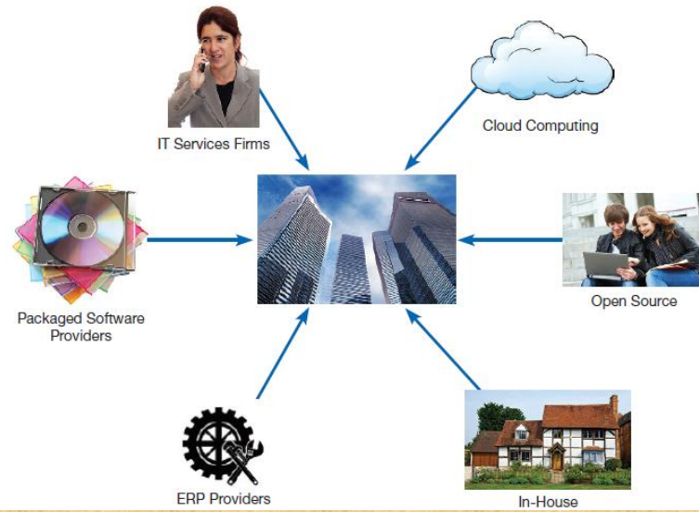
Sources of Software

Slide 6
six major categories:
information technology services firms
packaged software producers
enterprise-wide solutions
cloud computing vendors
open-source software
in-house developers

Slide 7
1. Information Technology Services Firms:
If a company/client needs an information system but does not have the expertise to develop the system s/he will likely consult an information technology services firm.
IT services firms help companies develop custom software/ information systems for internal use,
or they develop, host, and run applications for customers, or they provide other services.
Eg, if you want to run a blog post website but do not know how to build a website, these firms can provide you a software

Slide 8
2. Packaged Software Producers:
stand-alone systems that are produced by a development organization and sold on the open market to any customer who is able to buy them
Eg, Microsoft office, drawing packages and project management tools.
Also provide prepackaged or off-the-shelf software – some can be customized to suit customers needs, some cannot be customized.

Slide 9
3. Enterprise Solutions Software
• some firms choose enterprise solutions or enterprise resource planning (ERP) systems, to support their operations and business processes.
These consist of a series of integrated modules.
Each module supports an individual, traditional business function, such as accounting, distribution, manufacturing, or human resources.
difference between modules and traditional approaches is that the modules are integrated to focus on business processes rather than on business functional areas.
Eg, a series of modules will support the entire order entry process, from receiving an order, to adjusting inventory, to shipping to billing, to after-the-sale service.
traditional approach would use different systems in different functional areas of the business, such as a billing system in accounting and an inventory system in the warehouse.

Slide 10
Benefits
Flexibility of modules
single repository so, ensures more consistent and accurate data, as well as less maintenance.
Disadvantages
• systems are very complex, so implementation can take a long time to complete.

Slide 11
4. Cloud Computing
is the delivery of computing services—including servers, storage, databases, networking, software, analytics, and intelligence—over the internet
organizations can rent applications or license them from third-party providers who run the applications at remote sites.
Eg, Google Apps, where users can share and create documents, spreadsheets, and presentations
Eg, salesforce.com, Microsoft, amazon.com, azure (products- virtual machine, sql database)
Here customers do not have to invest in the hardware and software resources needed to run and maintain the applications.
application provider buys, installs, maintains, and upgrades the applications.
Users pay on a per-use basis or they license the software

Slide 12
5. Open-source software
Software is freely available, not just the final product but the source code itself.
Does not require license
Can be modified by anyone
Modified version may be redistributed
Open-source software performs the same functions as commercial software, such as operating systems, e-mail, database systems, web browsers, and so on.
Eg, Linux, an operating system; mySQL, a database system; and Firefox, a web browser.

Slide 13
6. In-House Development:
Building software from scratch
can lead to a larger maintenance burden than other development methods, such as packaged applications.

Slide 14
Reuse
Reuse is the use of previously written software resources in new applications.
Some of the components that can be reused are Source code, Design and interfaces, User manuals, Software Documentation, Software requirement specifications, and many more.
Commercial-off-the-shelf is ready-made software and components are ready-made components that can be reused for new software.

Slide 15
Stages of reuse-oriented software engineering
1. Requirement specification:
First of all, specify the requirements.
Specifies if we have existing software components for the development of new software or not.
2. Component analysis:
Helps to decide that which component can be reused where.
3. Requirement updations / modifications:
If requirements are changed by the customer, helps to specify existing components are helpful for reuse or not.
4. Reuse System design:
Specifies if we can reuse the existing software component design

Slide 16
5. Development:
Existing components code are matching with new software or not.
6. Integration:
Can we integrate the new systems with existing components?
7. System Validation:
To validate the system that it can be accepted by the customer or not.

Slide 17
Requirement Specification
Component Analysis
Requirement Modification
System Design
Development and Integration
System Validation
Figure: Reuse-oriented software engineering

Slide 18
Advantages of reuse
Less effort
Time-saving
Reduce cost
decrease development time
Increase programmer or software productivity
Utilize fewer resources
Leads to a better quality software.
lower defect rates
decreasing maintenance costs

